Slide 1

CASE-STUDY IPL AUCTION
Arjun Kumar

Slide 2
MOTIVE
Developing auction strategy for new IPL franchise by analyzing past IPL data to create a strong and balanced squad.

Slide 3
TASK - 1
Your first priority is to get 2-3 players with high S.R who have faced at least 500 balls. And to do that you have to make a list of 10 players you want to bid in the auction so that when you try to grab them in auction you should not pay the amount greater than you have in the purse for a particular player.​

Slide 4
Query for creating ‘deliveries’ table
CREATE TABLE deliveries(id int, innning int, over int, ball int, batsman varchar,
non_striker varchar, bowler varchar, batsman_runs int, extra_runs int, total_runs int,
is_wicket int, dismissal_kind varchar, player_dismissed varchar, fielder varchar,
extras_type varchar, batting_team varchar, bowling_team varchar);
COPY deliveries FROM 'C:\Program Files\PostgreSQL\16\data\IPL Dataset\IPL_Ball.csv'
DELIMITER ',' csv header;
SELECT * FROM deliveries;

Slide 5
Query for creating ‘matches’ table
CREATE TABLE matches(id int, city varchar, date date, player_of_match varchar, venue varchar, neutral_venue int, team1 varchar, team2 varchar, toss_winner varchar, toss_decision varchar, winner varchar, result varchar,
result_margin int, eliminator varchar, method varchar, umpire1 varchar, umpire2 varchar);
SELECT * FROM matches;
COPY matches FROM 'C:\Program Files\PostgreSQL\16\data\IPL Dataset\IPL_matches.csv' DELIMITER ',' csv header;

Slide 6
Query for Task -1
SELECT
batsman,
total_runs,
ball_faced,
Round((total_runs * 100.0 / ball_faced), 2) AS Strike_rate
FROM (SELECT
batsman, SUM(batsman_runs) AS total_runs,
(COUNT(ball) - COUNT(CASE WHEN extras_type = 'wides' THEN 1 END)) AS ball_faced
FROM
deliveries
GROUP BY
batsman
HAVING
COUNT(ball) - COUNT(CASE WHEN extras_type = 'wides' THEN 1 END) >= 500)
ORDER BY
Strike_rate DESC
LIMIT 10;

Slide 7
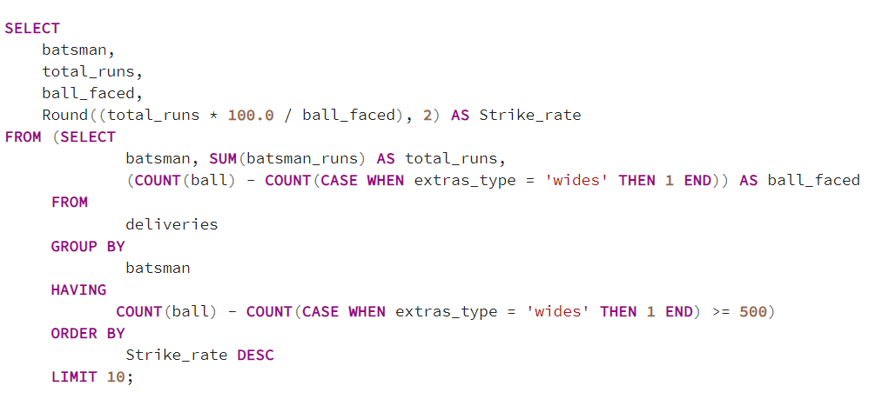
Query for Task -1

Slide 8
RESULT TABLE
batsman | total_runs | ball_faced | strike_rate
AD Russell | 1517 | 832 | 182.33
SP Narine | 892 | 543 | 164.27
HH Pandya | 1349 | 847 | 159.27
V Sehwag | 2728 | 1755 | 155.44
GJ Maxwell | 1505 | 973 | 154.68
RR Pant | 2079 | 1368 | 151.97
AB de Villiers | 4849 | 3192 | 151.91
CH Gayle | 4772 | 3179 | 150.11
KA Pollard | 3023 | 2017 | 149.88
JC Buttler | 1714 | 1146 | 149.56

Slide 9
Graphs and Charts

Slide 10
TASK - 2
Now you need to get 2-3 players with good Average who have played more the 2 IPL seasons. And to do that you have to make a list of 10 players you want to bid in the auction so that when you try to grab them in auction you should not pay the amount greater than you have in the purse for a particular player.

Slide 11
Query for Task -2
create table deliveries_v03 as (select a.*, b.venue, b.date as match_date from deliveries_v02 as a left join matches
as b on a.id = b.id order by id);
SELECT
batsman,
total_runs,
dismissal,
seasons,
(total_runs/ dismissal) AS Average
FROM (SELECT
batsman,
SUM(batsman_runs) AS total_runs,
COUNT(innning) as Num_of_innings,
COUNT(CASE WHEN player_dismissed <> 'NA' THEN 1 END) AS dismissal,
COUNT(DISTINCT EXTRACT(YEAR FROM match_date))
AS seasons
FROM deliveries_v03
GROUP BY
batsman
HAVING
COUNT(DISTINCT EXTRACT(YEAR FROM match_date)) > 2)
ORDER BY Average DESC
LIMIT 10;

Slide 12
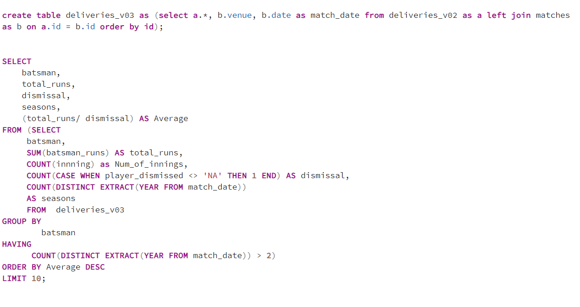
Query for Task - 2

Slide 13
RESULT TABLE
Batsman | Total runs | Dismissals | Seasons | Average
Iqbal Abdulla | 88 | 1 | 8 | 88
AB de Villiers | 4849 | 114 | 13 | 42
KL Rahul | 2647 | 62 | 7 | 42
ML Hayden | 1107 | 27 | 3 | 41
JP Duminy | 2029 | 49 | 8 | 41
CH Gayle | 4772 | 116 | 12 | 41
DA Warner | 5254 | 126 | 11 | 41
KS Williamson | 1619 | 41 | 6 | 39
LMP Simmons | 1079 | 27 | 4 | 39
MEK Hussey | 1977 | 52 | 7 | 38

Slide 14
Graphs and Charts

Slide 15
TASK - 3
Now you need to get 2-3 Hard-hitting players who have scored most runs in boundaries and have played more the 2 IPL season. To do that you have to make a list of 10 players you want to bid in the auction so that when you try to grab them in auction you should not pay the amount greater than you have in the purse for a particular player.

Slide 16

create table deliveries_v03 as (select a.*, b.venue, b.date as match_date from deliveries_v02 as a left join matches
as b on a.id = b.id order by id);
SELECT
batsman,
COUNT(*) AS Boundary_count,
SUM(batsman_runs) AS Boundary_runs
FROM
deliveries_v03
WHERE
batsman_runs >= 4
GROUP BY
batsman
HAVING
COUNT(DISTINCT EXTRACT(YEAR FROM match_date)) > 2
ORDER BY
Boundary_runs DESC
IMIT 10;

Slide 17
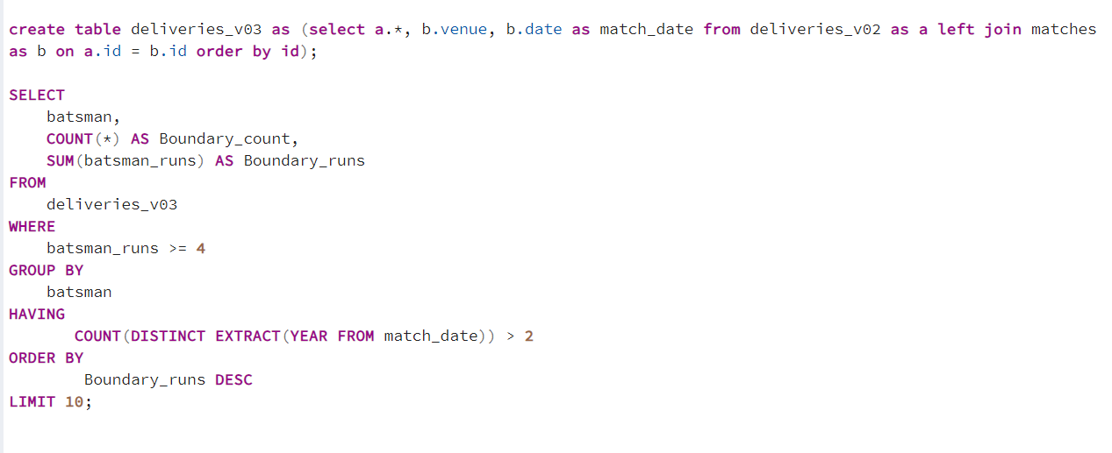
Query for Task - 3

Slide 18
RESULT TABLE
Batsman | Boundary Count | Boundary Runs
CH Gayle | 733 | 3630
V Kohli | 706 | 3228
DA Warner | 706 | 3215
SK Raina | 688 | 3141
RG Sharma | 673 | 3121
S Dhawan | 702 | 3028
AB de Villiers | 625 | 2970
RV Uthappa | 620 | 2809
SR Watson | 567 | 2649
MS Dhoni | 529 | 2548

Slide 19
Graphs and Charts

Slide 20
TASK - 4
Your first priority is to get 2-3 bowlers with good economy who have bowled at least 500 balls in IPL so far. To do that you have to make a list of 10 players you want to bid in the auction so that when you try to grab them in auction you should not pay the amount greater than you have in the purse for a particular player.

Slide 21

SELECT
bowler,
Runs_conceded,
Balls_bowled,
Round(Overs_bowled,2) as Overs_bowled,
ROUND((Runs_conceded / Overs_bowled), 2) AS Economy_rate
FROM (SELECT
bowler,
COUNT(ball) AS Balls_bowled,
SUM((total_runs) - CASE WHEN extras_type IN ('bye', 'legbyes') THEN 1 ELSE 0 END) AS Runs_conceded,
COUNT(ball) / 6.0 AS Overs_bowled
FROM
deliveries
GROUP BY
bowler
HAVING
COUNT(ball) >= 500)
ORDER BY
Economy_rate ASC
LIMIT 10;

Slide 22
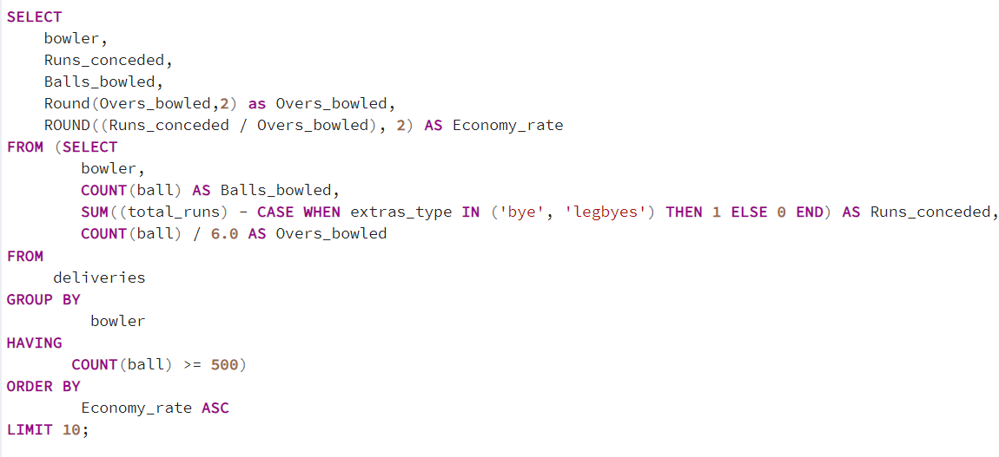
Query for Task - 4

Slide 23
RESULT TABLE
Bowler | Runs conceded | Balls bowled | Overs bowled | Economy rate
Rashid Khan | 1550 | 1490 | 248.33 | 6.24
A Kumble | 1066 | 983 | 163.83 | 6.51
M Muralitharan | 1716 | 1577 | 262.83 | 6.53
DW Steyn | 2528 | 2276 | 379.33 | 6.66
R Ashwin | 3717 | 3327 | 554.5 | 6.7
SP Narine | 3169 | 2824 | 470.67 | 6.73
DL Vettori | 882 | 785 | 130.83 | 6.74
Washington Sundar | 749 | 660 | 110 | 6.81
J Botha | 807 | 709 | 118.17 | 6.83
MA Starc | 705 | 612 | 102 | 6.91

Slide 24
Graphs and Charts

Slide 25
TASK - 5
Now you need to get 2-3 bowlers with the best strike rate and who have bowled at least 500 balls in IPL so far. To do that you have to make a list of 10 players you want to bid in the auction so that when you try to grab them in auction you should not pay the amount greater than you have in the purse for a particular player.

Slide 26

SELECT
bowler,
Balls_bowled,
Wickets_taken,
ROUND(CAST(Balls_bowled AS DECIMAL) / Wickets_taken, 2) AS Strike_rate
FROM (SELECT
bowler,
COUNT(ball) AS Balls_bowled,
(SUM(is_wicket) - SUM(CASE WHEN dismissal_kind IN ('bowled', 'lbw', 'stumped',
'caught and bowled', 'hit wicket') THEN 1 ELSE 0 END)) AS Wickets_taken
FROM
deliveries
GROUP BY
bowler
HAVING
COUNT(ball) >= 500)
ORDER BY
Strike_rate ASC
LIMIT 10;

Slide 27
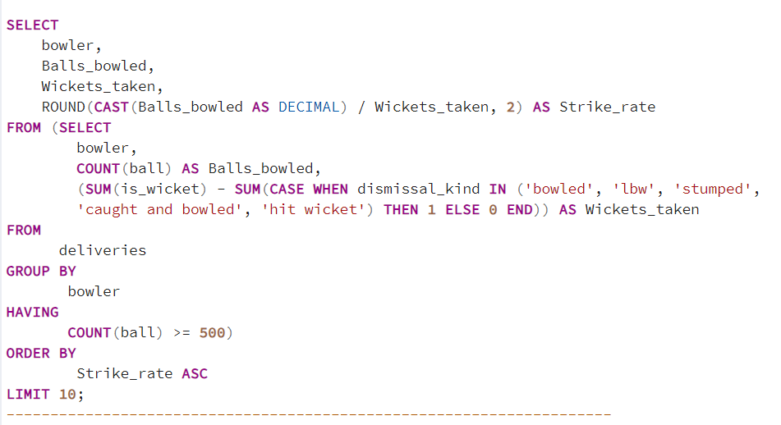
Query for Task - 5

Slide 28
RESULT TABLE
Bowler | Balls bowled | Wickets taken | Strike Rate
K Rabada | 840 | 55 | 15.27
AJ Tye | 645 | 39 | 16.54
DE Bollinger | 600 | 32 | 18.75
DJ Bravo | 2846 | 138 | 20.62
NM Coulter-Nile | 751 | 36 | 20.86
R Vinay Kumar | 2179 | 104 | 20.95
A Nehra | 1974 | 91 | 21.04
MJ McClenaghan | 1346 | 62 | 21.33
SN Thakur | 947 | 45 | 21.69
TA Boult | 1152 | 54 | 21.71

Slide 29
Graphs and Charts

Slide 30
TASK - 6
Now you need to get 2-3 All-Rounders with the best batting as well as bowling strike rate and who have faced at least 500 balls in IPL so far and have bowled minimum 300 balls. To do that you have to make a list of 10 players you want to bid in the auction so that when you try to grab them in auction you should not pay the amount greater than you have in the purse for a particular player.

Slide 31
Query for Task - 6
SELECT
a.batsman,
a.total_runs,
a.ball_faced,
ROUND((a.total_runs * 100.0 / a.ball_faced), 2) AS Bat_strike_rate,
b.Balls_bowled,
b.Wickets_taken,
ROUND(CAST(Balls_bowled AS DECIMAL) / Wickets_taken, 2) AS Bow_strike_rate
FROM (
SELECT
batsman,
SUM(batsman_runs) AS total_runs,
(COUNT(ball) - COUNT(CASE WHEN extras_type = 'wides' THEN 1 END)) AS ball_faced
FROM
deliveries
GROUP BY
batsman
HAVING
COUNT(ball) - COUNT(CASE WHEN extras_type = 'wides' THEN 1 END) >= 500) AS a
INNER JOIN
(SELECT bowler, COUNT(ball) AS Balls_bowled, (SUM(is_wicket) - SUM(CASE WHEN
dismissal_kind IN ('bowled', 'lbw', 'stumped', 'caught and bowled', 'hit wicket')
THEN 1 ELSE 0 END)) AS Wickets_taken
FROM deliveries
GROUP BY bowler
HAVING COUNT(ball) >= 300) AS b
ON a.batsman = b.bowler
ORDER BY Bow_strike_rate, Bat_strike_rate DESC limit 10;

Slide 32
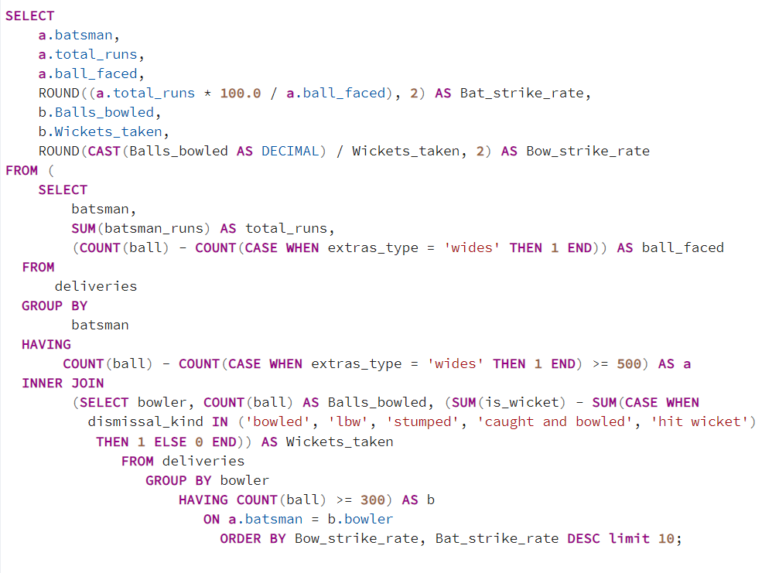
Query for Task - 6

Slide 33
RESULT TABLE
All-Rounders | Total Runs | Balls faced | Batting strike rate | Balls bowled | Wickets taken | Bowling strike rate
DJ Bravo | 1490 | 1162 | 128.23 | 2846 | 138 | 20.62
MP Stoinis | 825 | 601 | 137.27 | 562 | 25 | 22.48
AD Russell | 1517 | 832 | 182.33 | 1186 | 52 | 22.81
ST Jayasuriya | 768 | 532 | 144.36 | 301 | 13 | 23.15
HH Pandya | 1349 | 847 | 159.27 | 914 | 39 | 23.44
KA Pollard | 3023 | 2017 | 149.88 | 1414 | 57 | 24.81
SR Watson | 3874 | 2809 | 137.91 | 2137 | 86 | 24.85
MC Henriques | 969 | 756 | 128.17 | 918 | 36 | 25.5
JA Morkel | 974 | 686 | 141.98 | 1807 | 69 | 26.19
STR Binny | 880 | 683 | 128.84 | 611 | 21 | 29.1

Slide 34
Graphs and Charts

Slide 35
TASK - 7
Now suppose you are provided with a list of wicketkeeper names, and your task is to define the criteria for choosing the two best wicketkeepers from all those names. Try to define a criteria best suited for a wicketkeeper required in a t20 team so that your team will be complete and have everything required for winning this year’s IPL.

Slide 36
Criteria for selecting Wicketkeeper :-
1. My first priority will be to find a wicketkeeper whose batting style is explosive i.e. the batter having a good strike rate. A good strike is needed in T-20 and a wicketkeeper having a good strike can be crucial.
2. Secondly I will select a wicketkeeper who is part of their respective national team and is playing international matches on a regular basis. This criteria will ensure that the wicketkeeper is experienced and had previously played on Indian pitches as well.
3. One of the most important criteria for selecting the wicketkeeper will be to look for a wicketkeeper who can keep well in Indian conditions and his past record on spin friendly pitches and pitches where bounce is low for fast bowlers.
This is because IPL is mostly played in India and Indian pitches offer comparatively low bounce for fast bowlers and offer lot of spin and turn for spinners.
4. As IPL allows only limited number of foreign players in playing 11 so an Indian wicket-keeper can come in handy at a budget price.
All the above criteria can be used for selecting two best suited wicket-keepers for the team.

Slide 37
ADDITIONAL QUESTIONS

Slide 38

SELECT COUNT(DISTINCT city) AS host FROM matches;

Slide 39

Get the count of cities that have hosted an IPL match.
33 – cities have hosted the IPL matches.

Slide 40
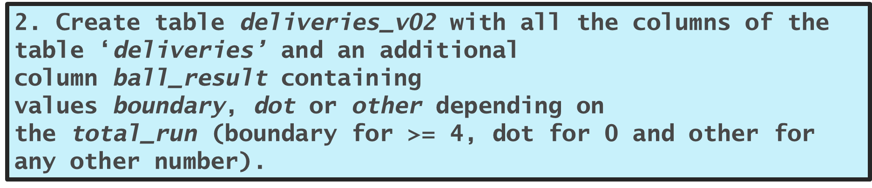
CREATE TABLE deliveries_v02 AS SELECT *,
CASE WHEN total_runs >= 4 THEN 'boundary'
WHEN total_runs = 0 THEN 'dot' ELSE 'Other'
END AS ball_result
FROM deliveries;

Slide 41
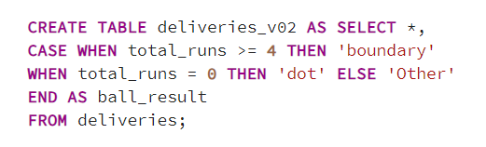
2. Create table deliveries_v02 with all the columns of the table ‘deliveries’ and an additional column ball_result containing values boundary, dot or other depending on the total_run (boundary for >= 4, dot for 0 and other for any other number).

Slide 42
RESULT TABLE
ID | Inning | Over | Ball | Batsman | Non- striker | Bowler | Batsman- runs | Extra- runs | Total- runs | Is- wicket | Dismissal- kind | Player- dismissed | Fielder | Extras- type | Batting- team | Bowling-team | Ball- result
335982 | 1 | 6 | 5 | RT Ponting | BB McCullum | AA Noffke | 1 | 0 | 1 | 0 | NA | NA | NA | NA | Kolkata Knight Riders | Royal Challengers Bangalore | Other
335982 | 1 | 6 | 6 | BB McCullum | RT Ponting | AA Noffke | 1 | 0 | 1 | 0 | NA | NA | NA | NA | Kolkata Knight Riders | Royal Challengers Bangalore | Other
335982 | 1 | 7 | 1 | BB McCullum | RT Ponting | Z Khan | 0 | 0 | 0 | 0 | NA | NA | NA | NA | Kolkata Knight Riders | Royal Challengers Bangalore | dot
335982 | 1 | 7 | 2 | BB McCullum | RT Ponting | Z Khan | 1 | 0 | 1 | 0 | NA | NA | NA | NA | Kolkata Knight Riders | Royal Challengers Bangalore | Other
335982 | 1 | 7 | 3 | RT Ponting | BB McCullum | Z Khan | 1 | 0 | 1 | 0 | NA | NA | NA | NA | Kolkata Knight Riders | Royal Challengers Bangalore | Other
335982 | 1 | 7 | 4 | BB McCullum | RT Ponting | Z Khan | 1 | 0 | 1 | 0 | NA | NA | NA | NA | Kolkata Knight Riders | Royal Challengers Bangalore | Other
335982 | 1 | 9 | 5 | BB McCullum | RT Ponting | SB Joshi | 6 | 0 | 6 | 0 | NA | NA | NA | NA | Kolkata Knight Riders | Royal Challengers Bangalore | boundary

Slide 43
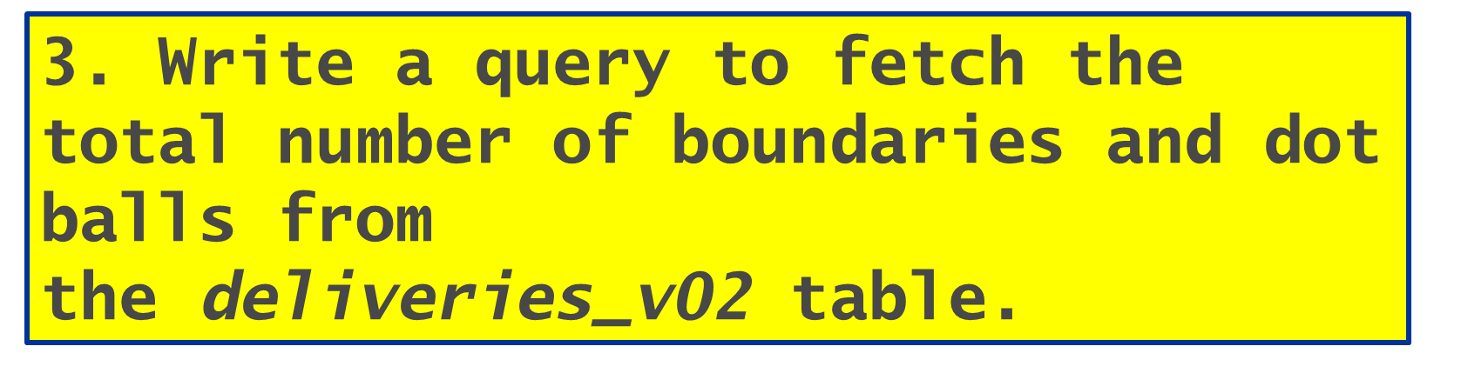
SELECT ball_result, COUNT(*) FROM deliveries_v02 GROUP BY ball_result;

Slide 44

3. Write a query to fetch the total number of boundaries and dot balls from the deliveries_v02 table.

Slide 45
RESULT TABLE
Ball- result | Count
Boundary | 31468
Dot | 67841
Other | 94159

Slide 46
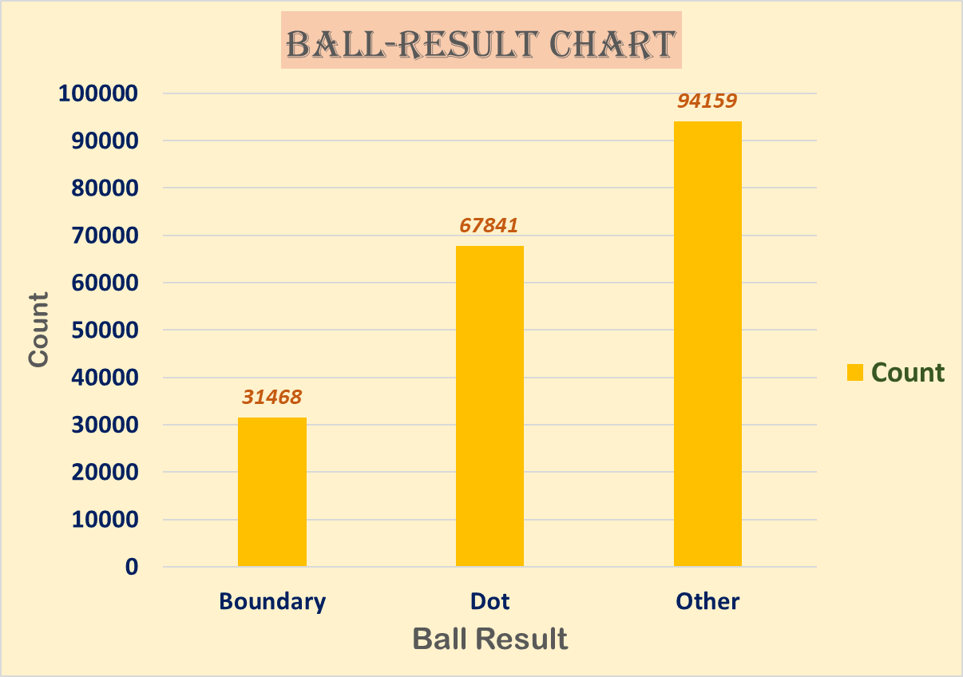
Graphs and Charts

Slide 47
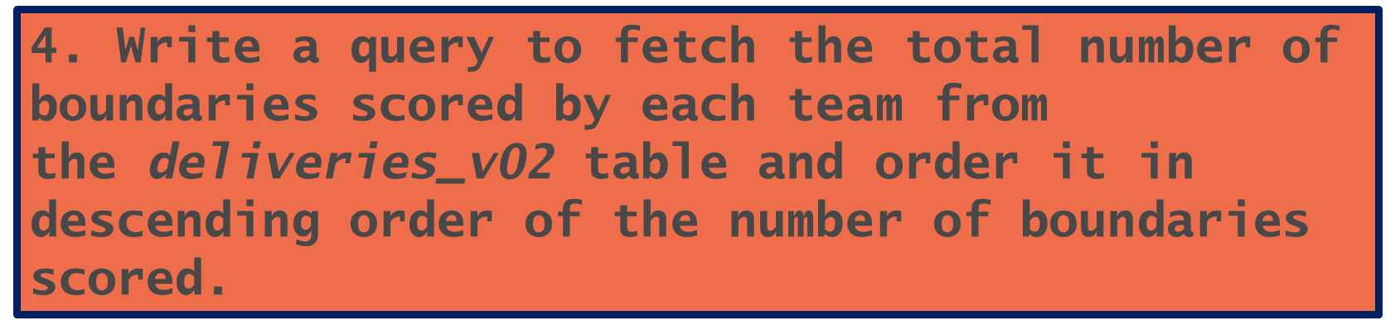
SELECT
batting_team,
COUNT(*) FROM deliveries_v02 WHERE ball_result = 'boundary'
GROUP BY batting_team
ORDER BY COUNT DESC;

Slide 48
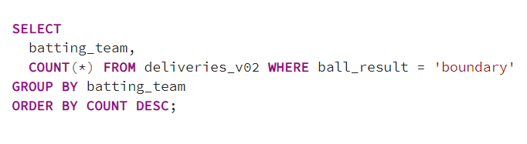
4. Write a query to fetch the total number of boundaries scored by each team from the deliveries_v02 table and order it in descending order of the number of boundaries scored.

Slide 49
RESULT TABLE
Teams | Boundary Count
Mumbai Indians | 4118
Royal Challengers Bangalore | 3800
Kings XI Punjab | 3780
Kolkata Knight Riders | 3739
Chennai Super Kings | 3496
Rajasthan Royals | 3041
Delhi Daredevils | 3022
Sunrisers Hyderabad | 2306
Deccan Chargers | 1387
Pune Warriors | 733
Delhi Capitals | 659
Gujarat Lions | 624
Rising Pune Supergiant | 290
Rising Pune Supergiants | 242
Kochi Tuskers Kerala | 231

Slide 50
Graphs and Charts

Slide 51
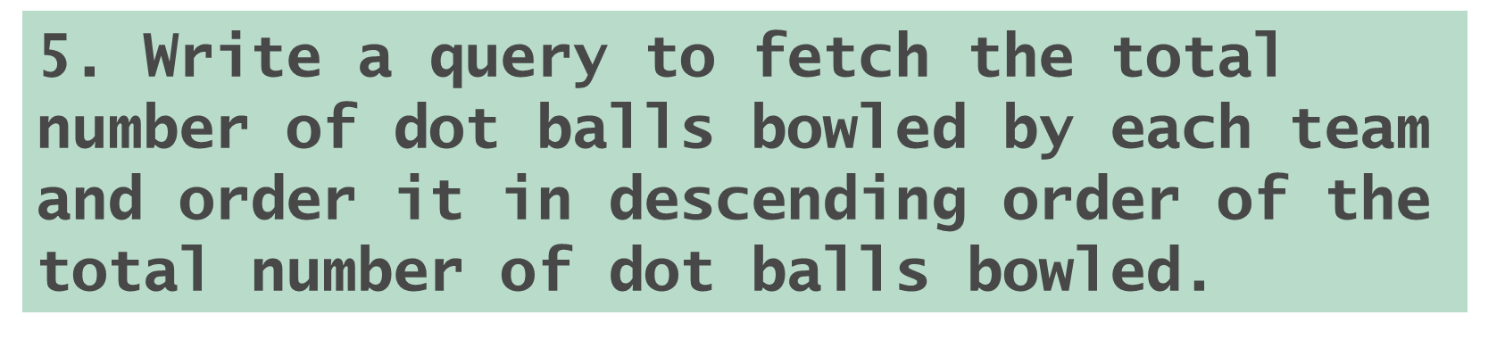
SELECT
bowling_team,
COUNT(*) FROM deliveries_v02 WHERE ball_result = 'dot'
GROUP BY bowling_team
ORDER BY COUNT DESC;

Slide 52
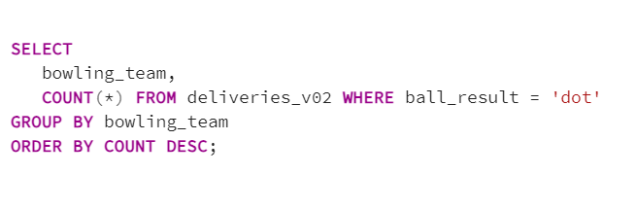
5. Write a query to fetch the total number of dot balls bowled by each team and order it in descending order of the total number of dot balls bowled.

Slide 53
RESULT TABLE
Teams | Dot Count
Mumbai Indians | 8714
Royal Challengers Bangalore | 7955
Kolkata Knight Riders | 7894
Kings XI Punjab | 7679
Chennai Super Kings | 7593
Rajasthan Royals | 6665
Delhi Daredevils | 6520
Sunrisers Hyderabad | 5248
Deccan Chargers | 3306
Pune Warriors | 1900
Delhi Capitals | 1338
Gujarat Lions | 1095
Rising Pune Supergiant | 698
Kochi Tuskers Kerala | 626
Rising Pune Supergiants | 539
NA | 71

Slide 54
Graphs and Charts

Slide 55
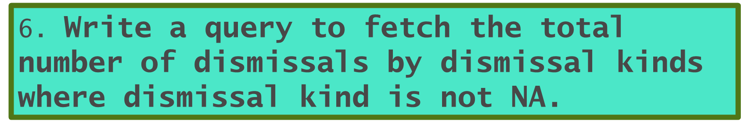
SELECT
dismissal_kind,
COUNT(*) FROM deliveries_v02 WHERE dismissal_kind <>'NA'
GROUP BY dismissal_kind
ORDER BY COUNT DESC;

Slide 56
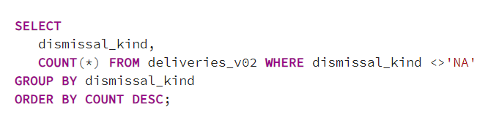
6. Write a query to fetch the total number of dismissals by dismissal kinds where dismissal kind is not NA.

Slide 57
RESULT TABLE
Dismissal Kind | Count Of Dismissals
Caught | 5743
Bowled | 1700
Run-Out | 893
LBW | 571
Stumped | 294
Caught and Bowled | 269
Hit-Wicket | 12

Slide 58
Graphs and Charts

Slide 59
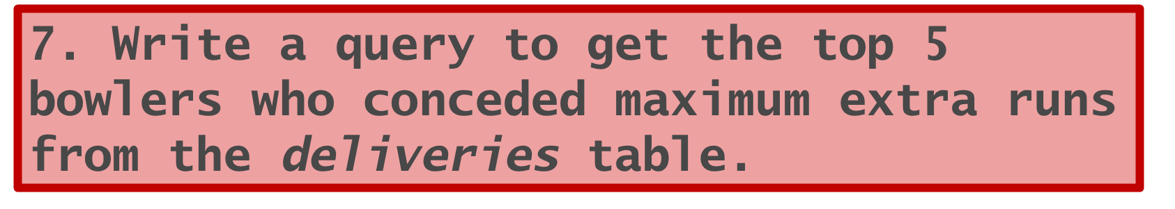
SELECT
bowler,
SUM(extra_runs) AS Extras_total
FROM deliveries
GROUP BY bowler
ORDER BY Extras_total DESC LIMIT 5;

Slide 60
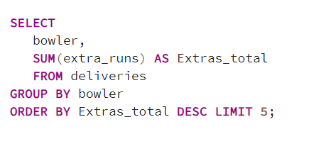
7. Write a query to get the top 5 bowlers who conceded maximum extra runs from the deliveries table.

Slide 61
RESULT TABLE
Bowler | Total Extras Conceded
SL Malinga | 293
P Kumar | 236
UT Yadav | 226
DJ Bravo | 210
B Kumar | 201

Slide 62
Graphs and Charts

Slide 63
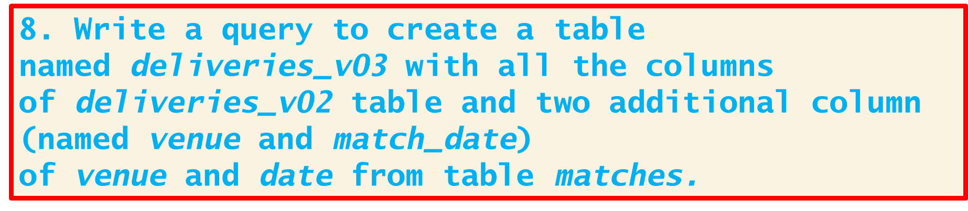
CREATE TABLE deliveries_v03
AS SELECT a.*, b.venue, b.match_date FROM deliveries_v02 AS a
LEFT JOIN
(SELECT MAX(venue) AS venue, MAX(date) AS match_date,
id FROM matches GROUP BY id) AS b
ON a.id = b.id;

Slide 64
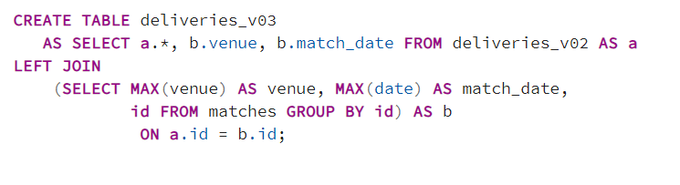
8. Write a query to create a table named deliveries_v03 with all the columns of deliveries_v02 table and two additional column (named venue and match_date) of venue and date from table matches.

Slide 65
RESULT TABLE
ID | Inning | Over | Ball | Batsman | Non- Striker | Bowler | Batsman- Runs | Extra-Runs | Total-Runs | Is-Wicket | Dismissal-Kind | Player-Dismissed | Fielder | Extras-Type | Batting-Team | Bowling-Team | Ball-Result | Venue | Match- Date
335982 | 1 | 6 | 5 | RT Ponting | BB McCullum | AA Noffke | 1 | 0 | 1 | 0 | NA | NA | NA | NA | Kolkata Knight Riders | Royal Challengers Bangalore | Other | M Chinnaswamy Stadium | 18-04-2008
335982 | 1 | 6 | 6 | BB McCullum | RT Ponting | AA Noffke | 1 | 0 | 1 | 0 | NA | NA | NA | NA | Kolkata Knight Riders | Royal Challengers Bangalore | Other | M Chinnaswamy Stadium | 18-04-2008
335982 | 1 | 7 | 1 | BB McCullum | RT Ponting | Z Khan | 0 | 0 | 0 | 0 | NA | NA | NA | NA | Kolkata Knight Riders | Royal Challengers Bangalore | dot | M Chinnaswamy Stadium | 18-04-2008
335982 | 1 | 7 | 2 | BB McCullum | RT Ponting | Z Khan | 1 | 0 | 1 | 0 | NA | NA | NA | NA | Kolkata Knight Riders | Royal Challengers Bangalore | Other | M Chinnaswamy Stadium | 18-04-2008
335982 | 1 | 7 | 3 | RT Ponting | BB McCullum | Z Khan | 1 | 0 | 1 | 0 | NA | NA | NA | NA | Kolkata Knight Riders | Royal Challengers Bangalore | Other | M Chinnaswamy Stadium | 18-04-2008
335982 | 1 | 7 | 4 | BB McCullum | RT Ponting | Z Khan | 1 | 0 | 1 | 0 | NA | NA | NA | NA | Kolkata Knight Riders | Royal Challengers Bangalore | Other | M Chinnaswamy Stadium | 18-04-2008

Slide 66
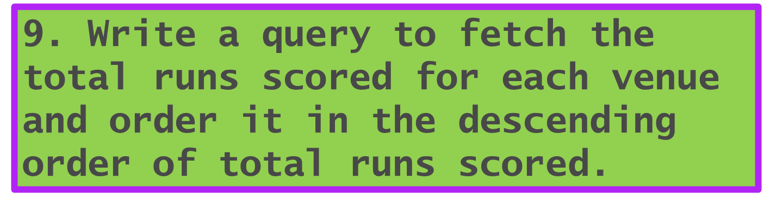
SELECT
venue,
SUM(total_runs) AS runs_scored
FROM deliveries_v03
GROUP BY venue
ORDER BY runs_scored DESC;

Slide 67
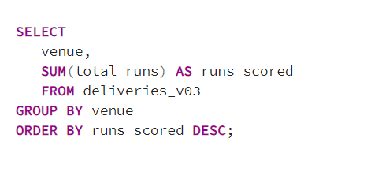
9. Write a query to fetch the total runs scored for each venue and order it in the descending order of total runs scored.

Slide 68
RESULT TABLE
Venue | Runs-Scored
Eden Gardens | 23658
Wankhede Stadium | 23390
Feroz Shah Kotla | 22947
M Chinnaswamy Stadium | 20237
Rajiv Gandhi International Stadium, Uppal | 19484
MA Chidambaram Stadium, Chepauk | 17821
Sawai Mansingh Stadium | 14264
Punjab Cricket Association Stadium, Mohali | 10987
Dubai International Cricket Stadium | 10402
Sheikh Zayed Stadium | 8830
Punjab Cricket Association IS Bindra Stadium, Mohali | 7021
Maharashtra Cricket Association Stadium | 6780
Sharjah Cricket Stadium | 5924
M.Chinnaswamy Stadium | 5127
Dr DY Patil Sports Academy | 4810
Subrata Roy Sahara Stadium | 4755
Kingsmead | 4353
Brabourne Stadium | 3842
Dr. Y.S. Rajasekhara Reddy ACA-VDCA Cricket Stadium | 3746
Sardar Patel Stadium, Motera | 3746
SuperSport Park | 3653
Saurashtra Cricket Association Stadium | 3316
Himachal Pradesh Cricket Association Stadium | 2897
Holkar Cricket Stadium | 2872
New Wanderers Stadium | 2292
Barabati Stadium | 2278
JSCA International Stadium Complex | 2056
St George's Park | 2033
Newlands | 1764
Shaheed Veer Narayan Singh International Stadium | 1741
Nehru Stadium | 1363
Green Park | 1298
De Beers Diamond Oval | 897
Vidarbha Cricket Association Stadium, Jamtha | 882
Buffalo Park | 799
OUTsurance Oval | 529

Slide 69
10. Write a query to fetch the year-wise total runs scored at Eden Gardens and order it in the descending order of total runs scored.
SELECT
EXTRACT (YEAR FROM match_date) AS Ipl_year,
SUM(total_runs) AS runs_scored
FROM deliveries_v03
WHERE venue = 'Eden Gardens'
GROUP BY Ipl_year
ORDER BY runs_scored DESC;

Slide 70
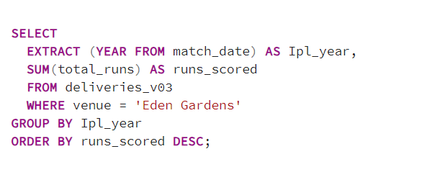
10. Write a query to fetch the year-wise total runs scored at Eden Gardens and order it in the descending order of total runs scored.

Slide 71
RESULT TABLE
IPL YEAR | Runs Scored
2018 | 2885
2019 | 2651
2015 | 2386
2013 | 2304
2017 | 2194
2010 | 2167
2016 | 2073
2012 | 2012
2011 | 1854
2008 | 1843
2014 | 1289

Slide 72
Graphs and Charts

Slide 73
Thank you
Arjun Kumar
Theamazingarjun@gmail.com PGC Data Science Course (December 15th Batch)

